Slide 1

Strategy Workshop

Slide 2
Workshop Goals
Develop an all agreed vision to position Baselhack in the region
Decide on goals we want to reach this year
Gain a common understanding of the BaselHack organisation and its members

Slide 3
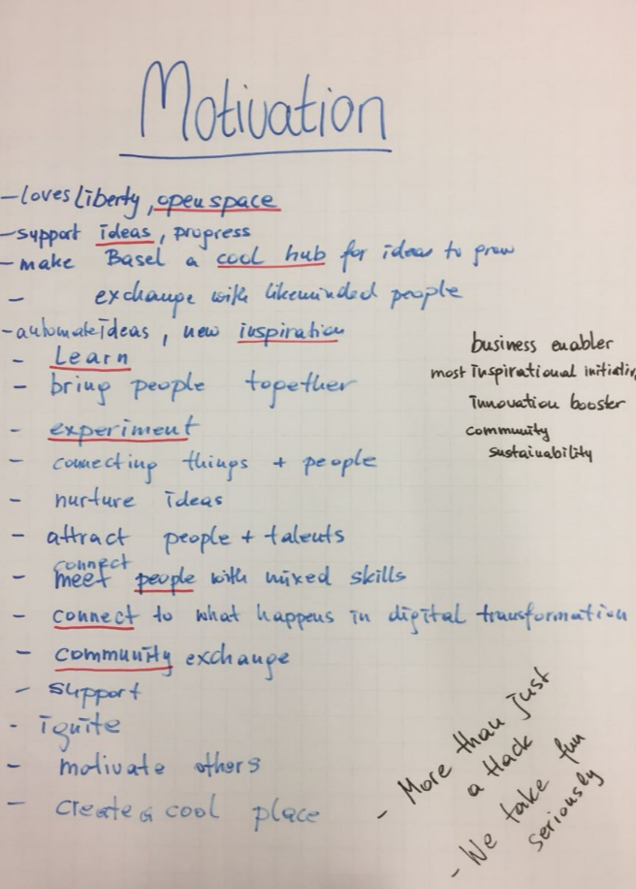
Introduction round
Partner up in teams of two
Find out from your partner
- why she or he is part of the BaselHack team
- What skills she or he wants to bring in
- Decide for a symbol that fits she or him

Slide 4
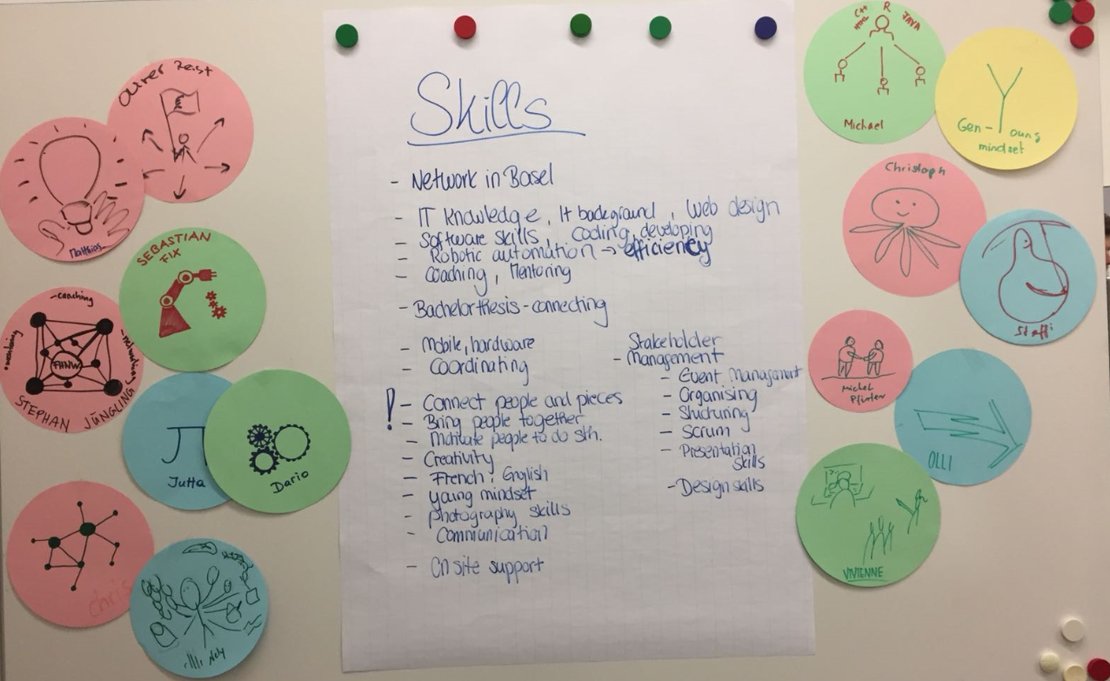
→ We have a great variety of skill sets in the team – however communication was only mentioned once and will be critical in 2018

Slide 5
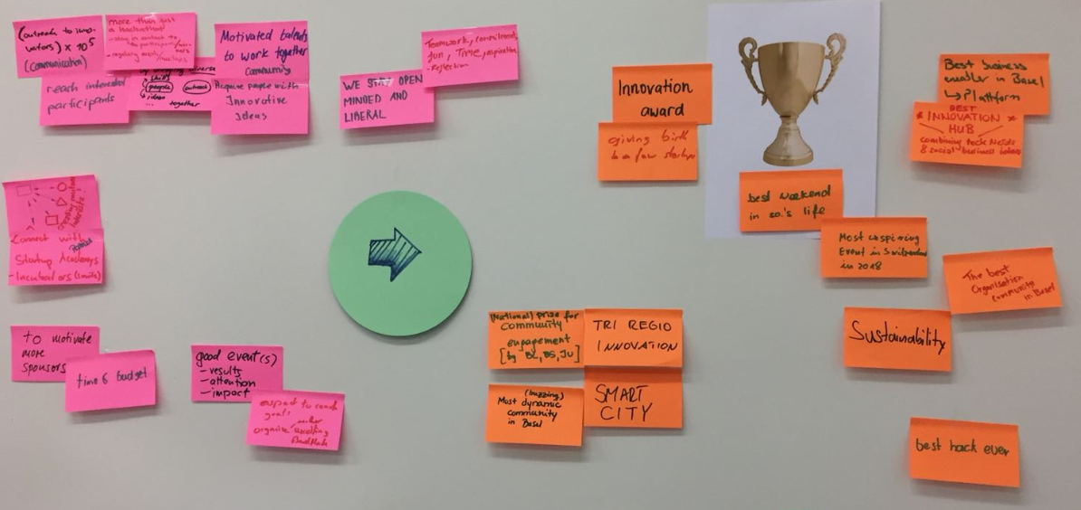
Vision development
Imagine we are going to win an award in November 2018….
What did we do in order to get it?
What award would that be?

Slide 6
More than just a Hackathon
BaselHack is as well known as the Basel Fasnacht
Join and feel inspired
BaselHack – more than just Basel
BaselHack is organised like the Basel Fasnacht, its relaxed but we take the fun serious
Connecting talents by creating attractive events
We take fun serious and create a market place for technical and social innovation in Basel
BaselHack enables fun, connects people and drives innovation
BaselHack – the fun and friendly international innovation hub
BaselHack – the place where innovation grows
BaselHack – join and feel inspired by not just a Hackathon. We take fun serious.
BaselHack is more than just a Hackathon – we connect people and take fun seriously to incubate the future
BaselHack is more than just a Hackathon – we connect people and take fun seriously to grow innovation
We connect and inspire people, take fun seriously to grow open innovation and communities
BaselHack is more than a Hackathon, we are community that drives open innovation by inspiring people
BaselHack is more than a Hackathon – driving open innovation by inspiring people and connecting communities
…

Slide 7
“BaselHack is more than a Hackathon – we connect people, take fun seriously and grow open innovation”
Vision of BaselHack

Slide 8
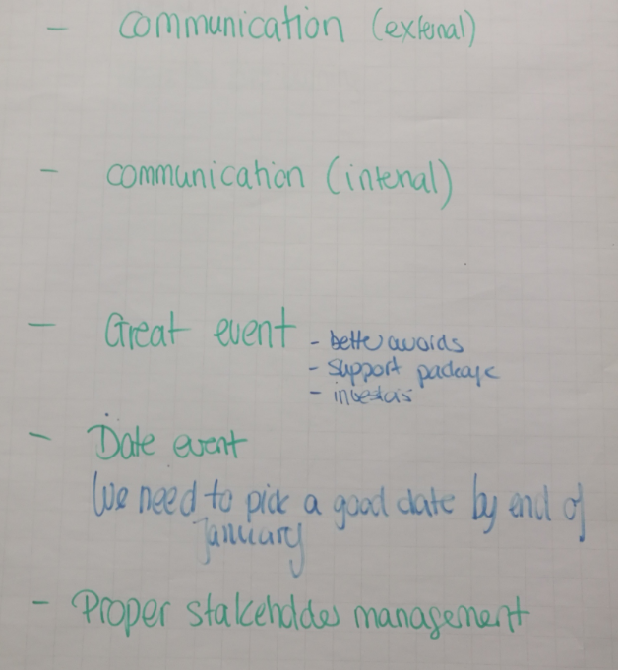
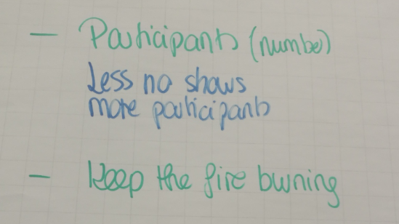
Defining Goals
Next meeting we have to define concrete goals and work packages around these cornerstones

